Slide 1


Introduction to Python – Block 3 Week 4
Mark Smith

Slide 2
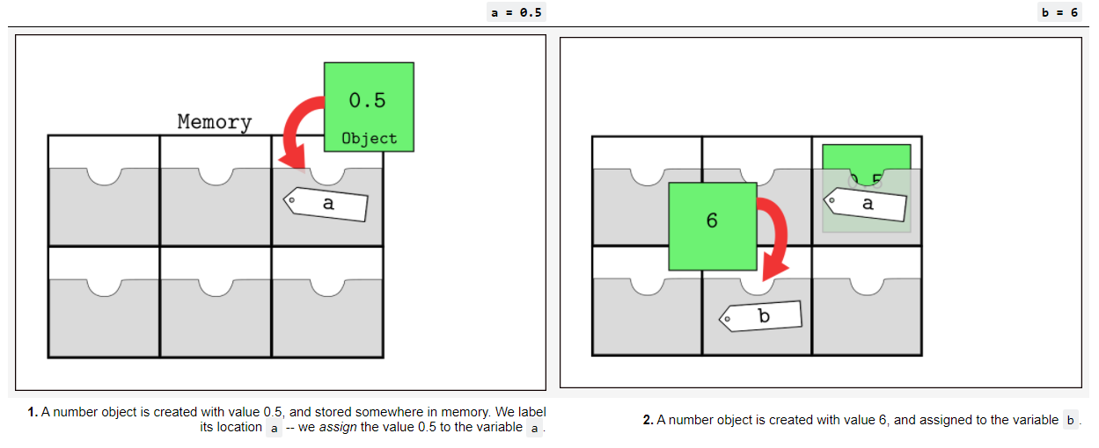
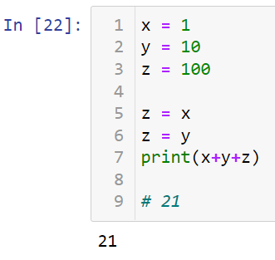
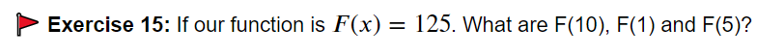
Last Week
Last week we looked at:
How Python stores variables
How to work with variables
How basic functions work

Slide 3
This Week
Last week we looked at:
How do basic conditional statements work
How do more complicated conditional statements work
How does control flow work

Slide 4
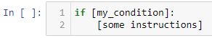
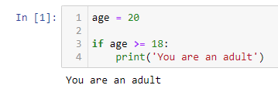
Basic Conditional statements
We have already looked at conditional statements in the past, they look something like:
OR, for example:
Notes:
Explain then go to worksheet

Slide 5
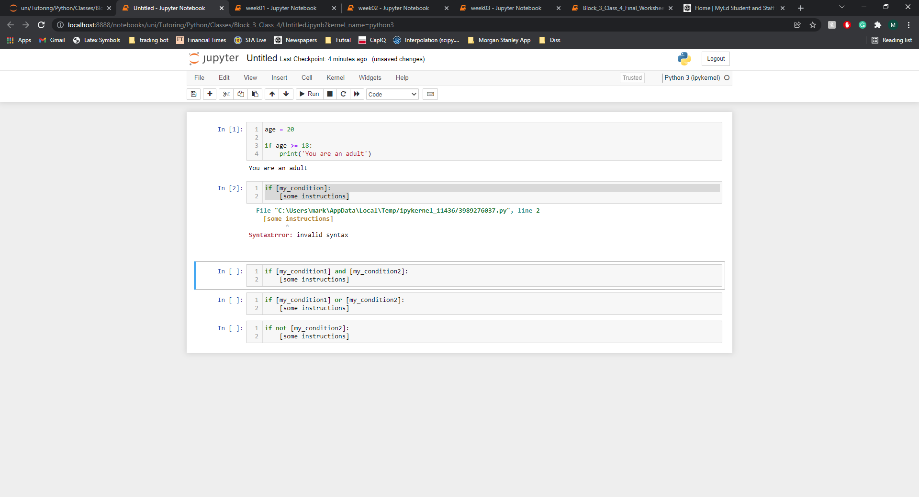
Conditional statements
We can check more than one condition at a time using the keywords,
Notes:
Explain then go to worksheet

